Slide 1

Healthcare Employee Attrition
Chandan Saha – Unsupervised Algorithms in Machine Learning

Slide 2

INTRODUCTION
EDA
MODELING
ANALYSIS
CONCLUSION

Slide 3

Introduction
We are looking at employee attrition in the healthcare industry.
The dataset we will be using is the NSI National Health Care Retention and RN Staffing report conducted in January 2022.
3,000 Hospitals were invited for this study. The dataset contains responses from 272 hospitals from 32 states.
In total it covers 589,901 healthcare workers and 166,087 RNs.
Our job is to take the different factors that goes into the job and develop unsupervised machine learning model that is able to show us relationships between the different features of the employees.

Slide 4
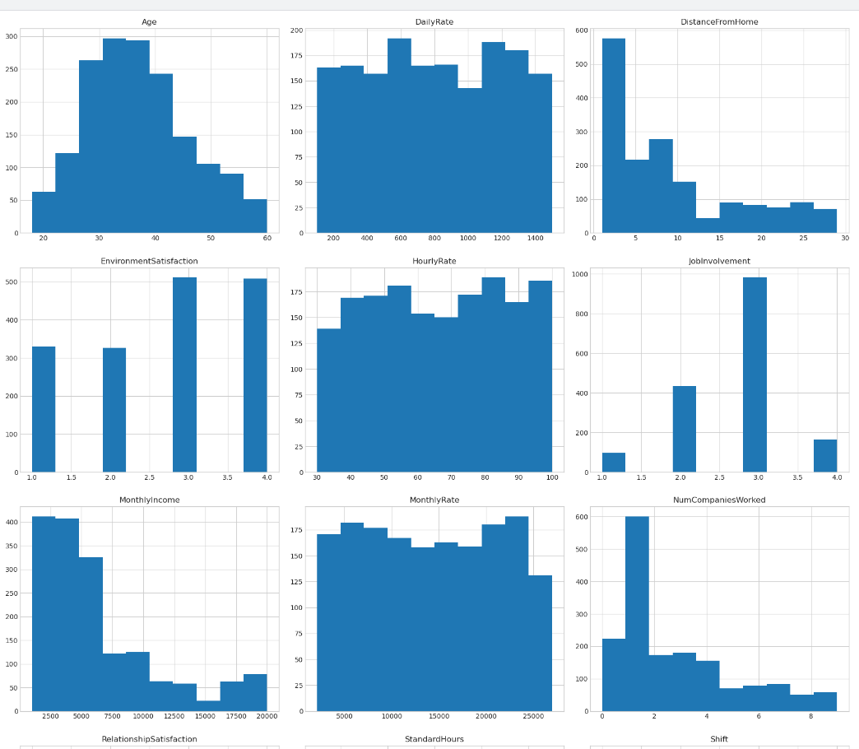
EDA
Examine data (35 features and 1676 observations)
Synthetic Data (No null values)
26 numerical features
Histogram plot of some of the numerical features.

Slide 5
EDA
Age seems to follow a somewhat normal distribution with most employees in their 30s and early 40s.
DistanceFromHome is right-skewed, indicating that many employees live close to their workplace.
TotalWorkingYears is also right-skewed, with most employees having less than 10 total working years.
YearsAtCompany, YearsInCurrentRole, YearsSinceLastPromotion, and YearsWithCurrManager are all right-skewed, indicating that most employees have fewer years in their current role, with the company, since their last promotion, and with their current manager.
Histogram plot of some of the numerical features.

Slide 6
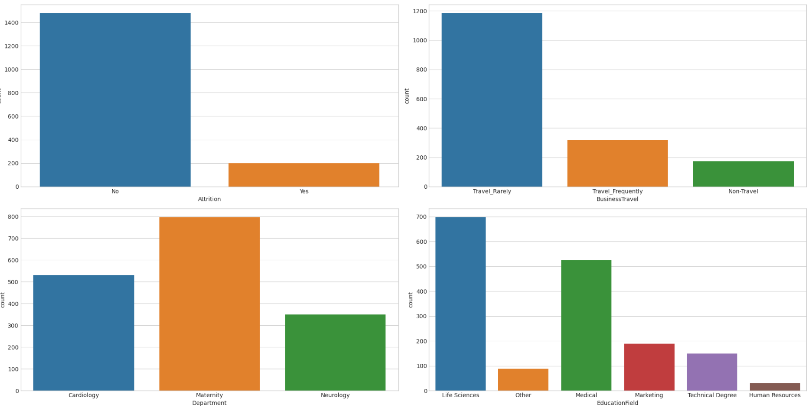
EDA
Attrition: A majority of employees have not left the company (No), while a smaller number have (Yes).
Department: The Maternity department has the most employees, followed by Cardiology.
EducationField: The most common fields of study are Life Sciences and Medical, followed by Marketing, Technical Degree, Other, and Human Resources.
Bar graph plot of some of the categorical features.

Slide 7
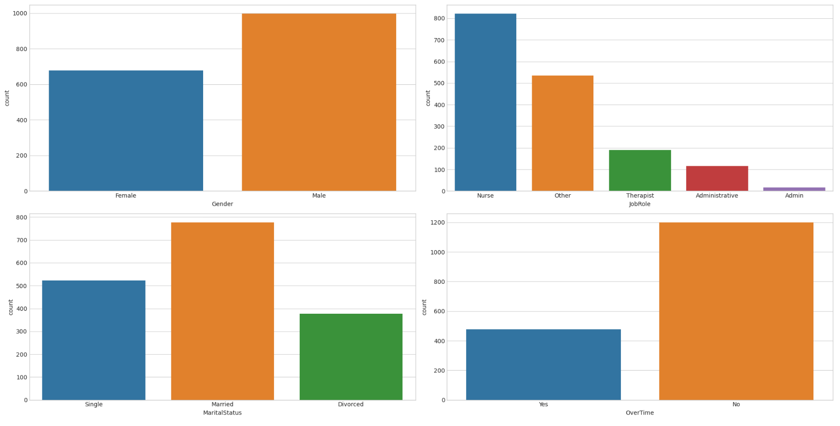
EDA
Gender: There are more Male employees than Female.
JobRole: There are various job roles in the dataset, with Physician being the most common, followed by Nurse and Healthcare Representative.
MaritalStatus: The majority of employees are Married, followed by Single and Divorced.
OverTime: Most employees do not work overtime (No).
Bar graph plot of some of the categorical features.

Slide 8

Model

Slide 9

K- Means Clustering
We will also determine the optimal number of clusters using the Elbow method.
This involves running the algorithm with different numbers of clusters and looking for a "bend" in the plot of cost versus number of clusters.
The optimal number of clusters is typically considered to be at this "elbow point".

Slide 10
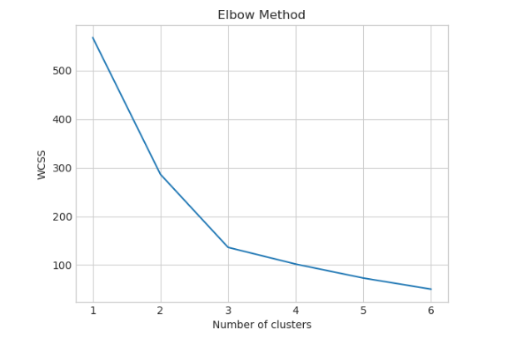
Elbow Method
The Elbow Method plot shows the total within-cluster sum of square (WCSS) against the number of clusters. Ideally, we look for a "bend" in the plot that represents an optimal number of clusters. In this plot, there isn't a clear "bend". However, a reasonable choice may be 2 or 3 clusters, as after that the decrease in WCSS becomes more gradual.
We will proceed to using 3 clusters

Slide 11
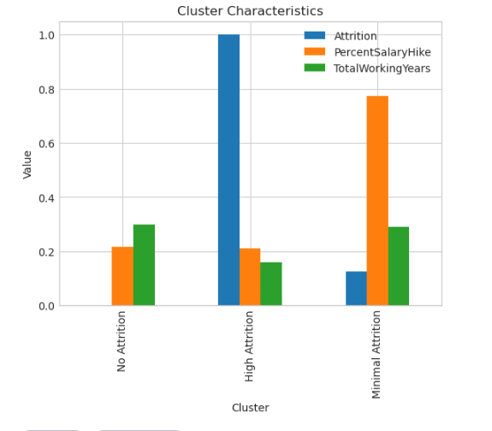
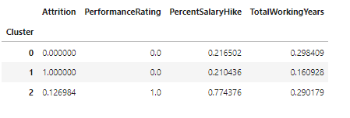
Initial Model
Initial clustering method we can see that minimal and no attrition employees were clustered with higher total working years. Which makes sense because people who have worked for a long time are less likely to want to change jobs.
Also we can see that high attrition was clustered with the lowest percent salary hike and the lowest total working years. This also makes sense because employees who believe they are not getting compensated fairly and are earlier in their careers are more prone to leaving.
K-means cluster (3) results showing the 3 clusters with the mean value of each feature in each cluster.

Slide 12
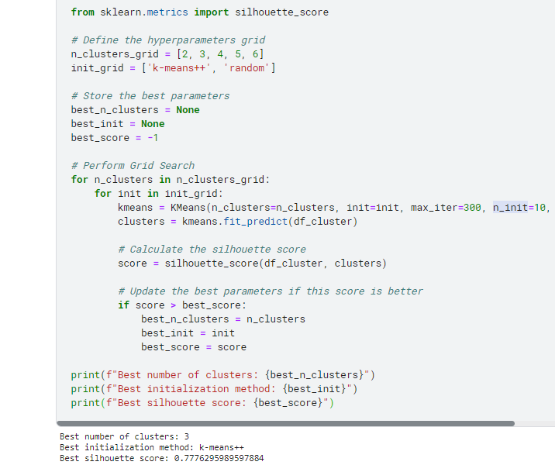
Hyper-Parameter Tuning
Optimizing our hyper-parameters to obtain better clustering. One method we can use is the silhouette score. The silhouette score measures the quality of the clustering by calculating how close each point in one cluster is to the points in the neighboring clusters. It ranges from -1 to 1, with higher scores indicating better clustering.

Slide 13
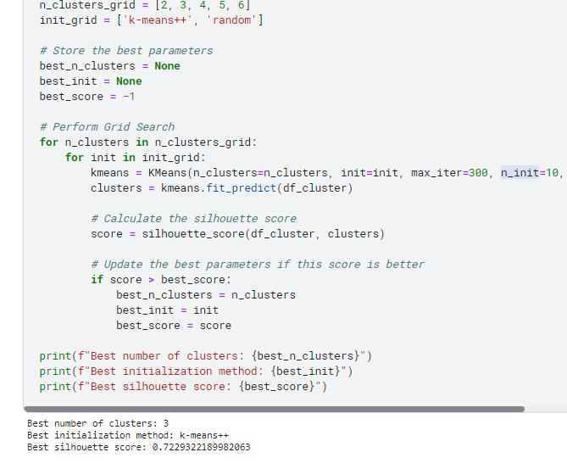
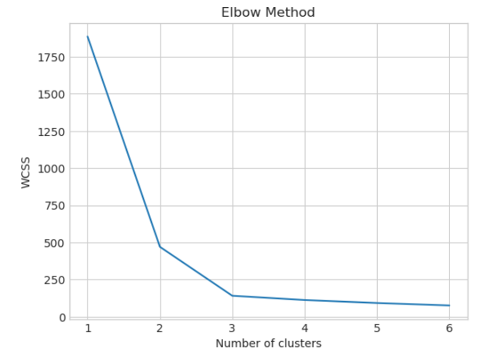
Attrition vs Age and Relationship Satisfaction
Elbow Method
Silhouette score – Cluster – 3 Initialization K++

Slide 14
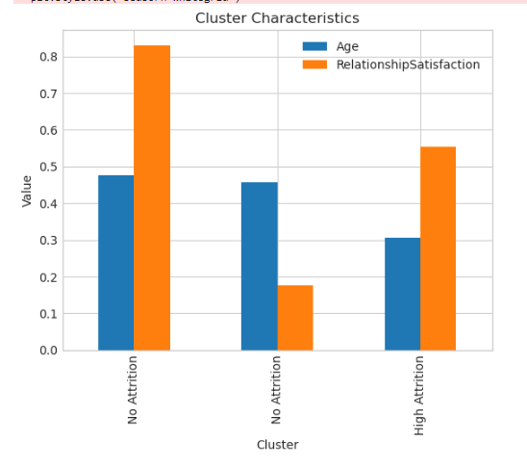
Attrition vs Age and Relationship Satisfaction
It seems that the biggest difference between the No and High attrition clusters was age. This makes sense since younger people might be more okay with changing jobs earlier in their lives since they might not be settled down with kids and families.
What is interesting is that it does not seem like relationship satisfaction did not play any role.
Both no attrition clusters had people of higher age with drastically different relationship satisfactions.

Slide 15

Conclusion
Our cluster model provided some interesting insights into the attrition of healthcare workers. Much of what I learned from this clustering model I believe can also be applied to other industries. Mainly that younger employees who are not getting compensated well, are the most prone to attrition.

Slide 16

Thoughts
Running the models and finding the best hyper-parameters went smoothly and using the elbow method did help us find the optimal number of clusters to use for our k means clustering each time, which was further validated through obtaining our silhouette scores.
Future thoughts on this project would be that maybe I would want use a random forest to predict whether an employee would be prone to attrition. I think that would be another interesting case to model.

Slide 17

References and Links
Healthcare Employee attrition Dataset: https://www.kaggle.com/datasets/jpmiller/employee-attrition-for-healthcare
Personal Github:
https://github.com/Chanksyou/Employee-Attrition-Healthcare

Slide 18
thank you
Chandan Saha
https://github.com/Chanksyou/
Unsupervised Algorithms in Machine Learning

